Slide 1
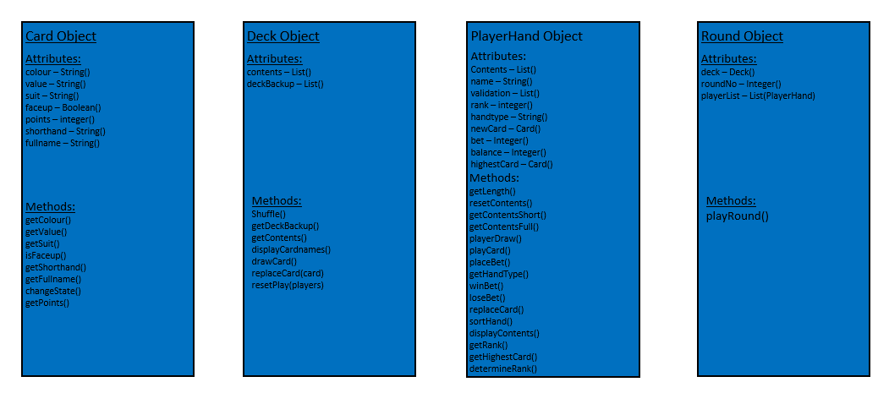
Card Object
Deck Object
PlayerHand Object
Round Object
Attributes:
colour – String()
value – String()
suit – String()
faceup – Boolean()
points – integer()
shorthand – String()
fullname – String()
Attributes:
contents – List()
deckBackup – List()
Attributes:
Contents – List()
name – String()
validation – List()
rank – integer()
handtype – String()
newCard – Card()
bet – Integer()
balance – Integer()
highestCard – Card()
Attributes:
deck – Deck()
roundNo – Integer()
playerList – List(PlayerHand)
Methods:
getLength()
resetContents()
getContentsShort()
getContentsFull()
playerDraw()
playCard()
placeBet()
getHandType()
winBet()
loseBet()
replaceCard()
sortHand()
displayContents()
getRank()
getHighestCard()
determineRank()
Methods:
getColour()
getValue()
getSuit()
isFaceup()
getShorthand()
getFullname()
changeState()
getPoints()
Methods:
Shuffle()
getDeckBackup()
getContents()
displayCardnames()
drawCard()
replaceCard(card)
resetPlay(players)
Methods:
playRound()

